Slide 1
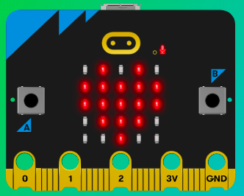
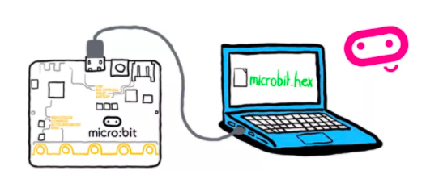
MicroMakers!
KIDS’ MAKER CLUB OF WASHINGTON, DC
Meet Up #4

Slide 2
RECAP!
Sensors – Analogy
Light Sensor as an Input
Accelerometer as an Input
Notes:
LEDs, Buttons, Light Sensor

Slide 3
Recap: If-Then-Else
Finish these sentences:
If it is raining outside, then I will wear _____________. Else, I will wear ____________.
If it is her 10th birthday, I will buy her a ______________. Else, if it is her 11th birthday, I would buy her a ________________. Else, I would just get her a ________________.
If he is not allergic to tacos, I will make ________________. Else, I will make _______________________.

Slide 4
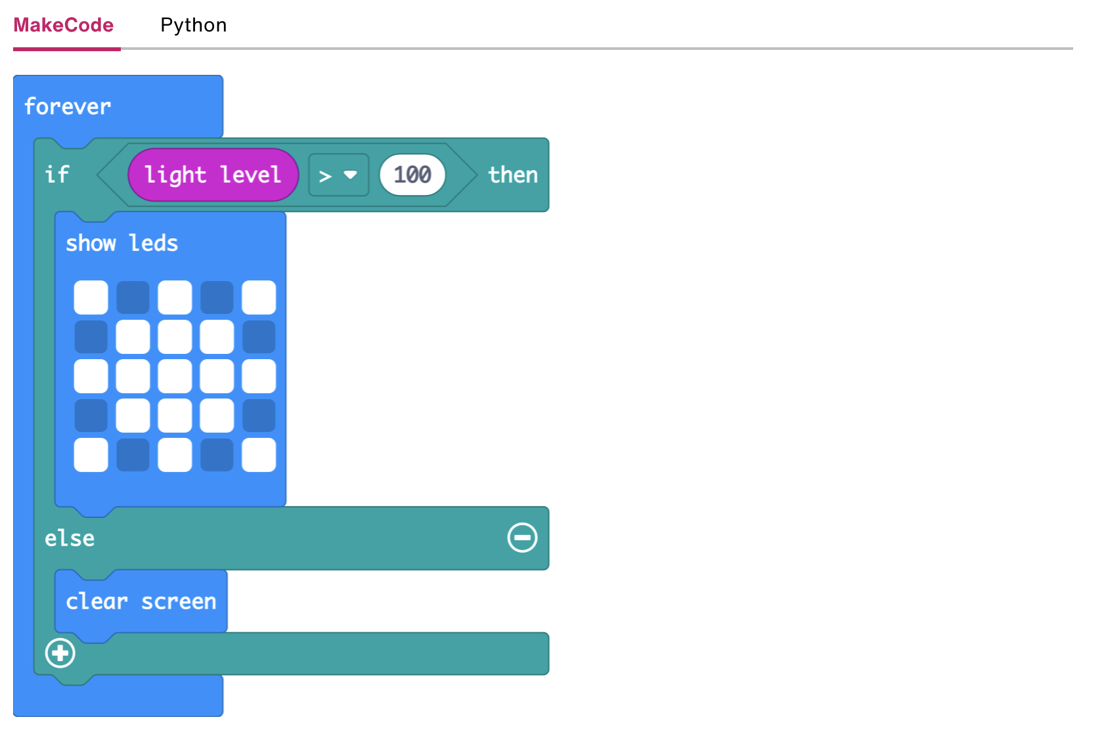
Recap: Reading Code
Read the Code!
For as long as the micro:bit is on:
If the light level is greater than 100, then
Show this picture using LEDs.
Else,
Clear the screen.

Slide 5
Recap: Light Level; If-Then-Else
Input: Light Level
Using the simulator, can you determine the light sensor’s level range?
If, then, else statement
If “something is true”, then “do this”.
Else, “do that”
“Something is true”
If a number > a target
If the given answer = the correct answer

Slide 6
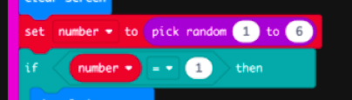
Recap: Variables
Are Your Friends!
Variables vs. Constants
A number variable could hold numerical data such as the year, the temperature, or you age.
A string variable holds text such as a person’s name, a password, or the day of the week.
A boolean variable has only two values: true or false.
A sprite is a special variable that represents a single dot on the screen and holds two separate values for the row and column the dot is currently in.
Notes:
Computer programs process information. Some of the information that is input, stored, and used in a computer program has a value that is constant, meaning it does not change throughout the course of the program. An example of a constant is your name, because it doesn’t change. Other pieces of information have values that vary or change during the running of a program. Programmers create variables to hold the value of information that may change. In a game program, a variable may be created to hold the player’s current score, since that value would change (hopefully!) during the course of the game.
Ask the students to think of some pieces of information in their daily life that are constants and others that are variables.
What pieces of information have values that don’t change during the course of a single day (constants)?
What pieces of information have values that do change during the course of a single day (variables) Constants and variables can be numbers and/or text.

Slide 7
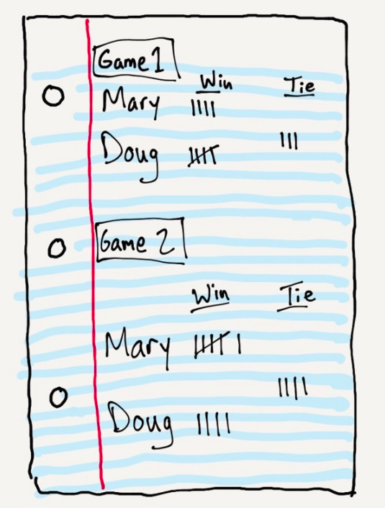
Recap: Variables
Are Your Friends!
Notes:
In this example, what are the variables? What are the constants?

Slide 8
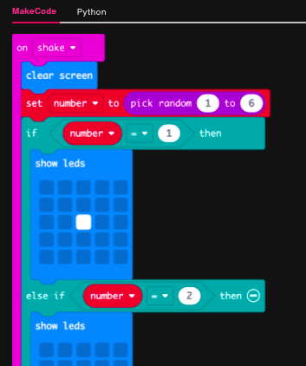
Recap: Code Reading
Read the Code!
When the micro:bit is shaken:
Clear the screen
Set “number” variable to = a random number between 1 and 6.
If the randomly selected value for “number” = 1, then:
Display this picture with LEDs
Else if the randomly selected value for “number” = 2, then:
Display this picture with LEDs

Slide 9
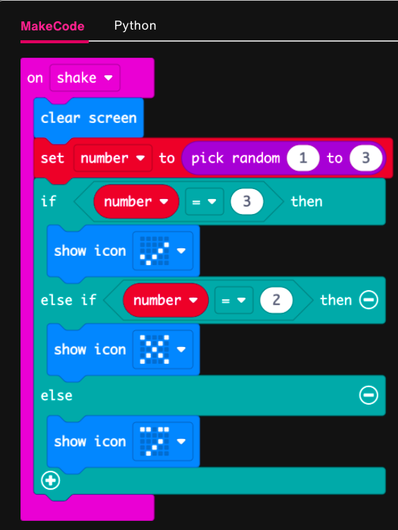
Recap: Code Reading
Read the Code!
When the micro:bit is shaken:
Clear the screen
Set “number” variable to = a random number between 1 and 3.
If the randomly selected value for “number” = 3, then:
Display this picture with LEDs
Else if the randomly selected value for “number” = 2, then:
Display this picture with LEDs
Else:
Display this picture with LEDs

Slide 10
Accelerometers
Loving the Accelerometer

Slide 11
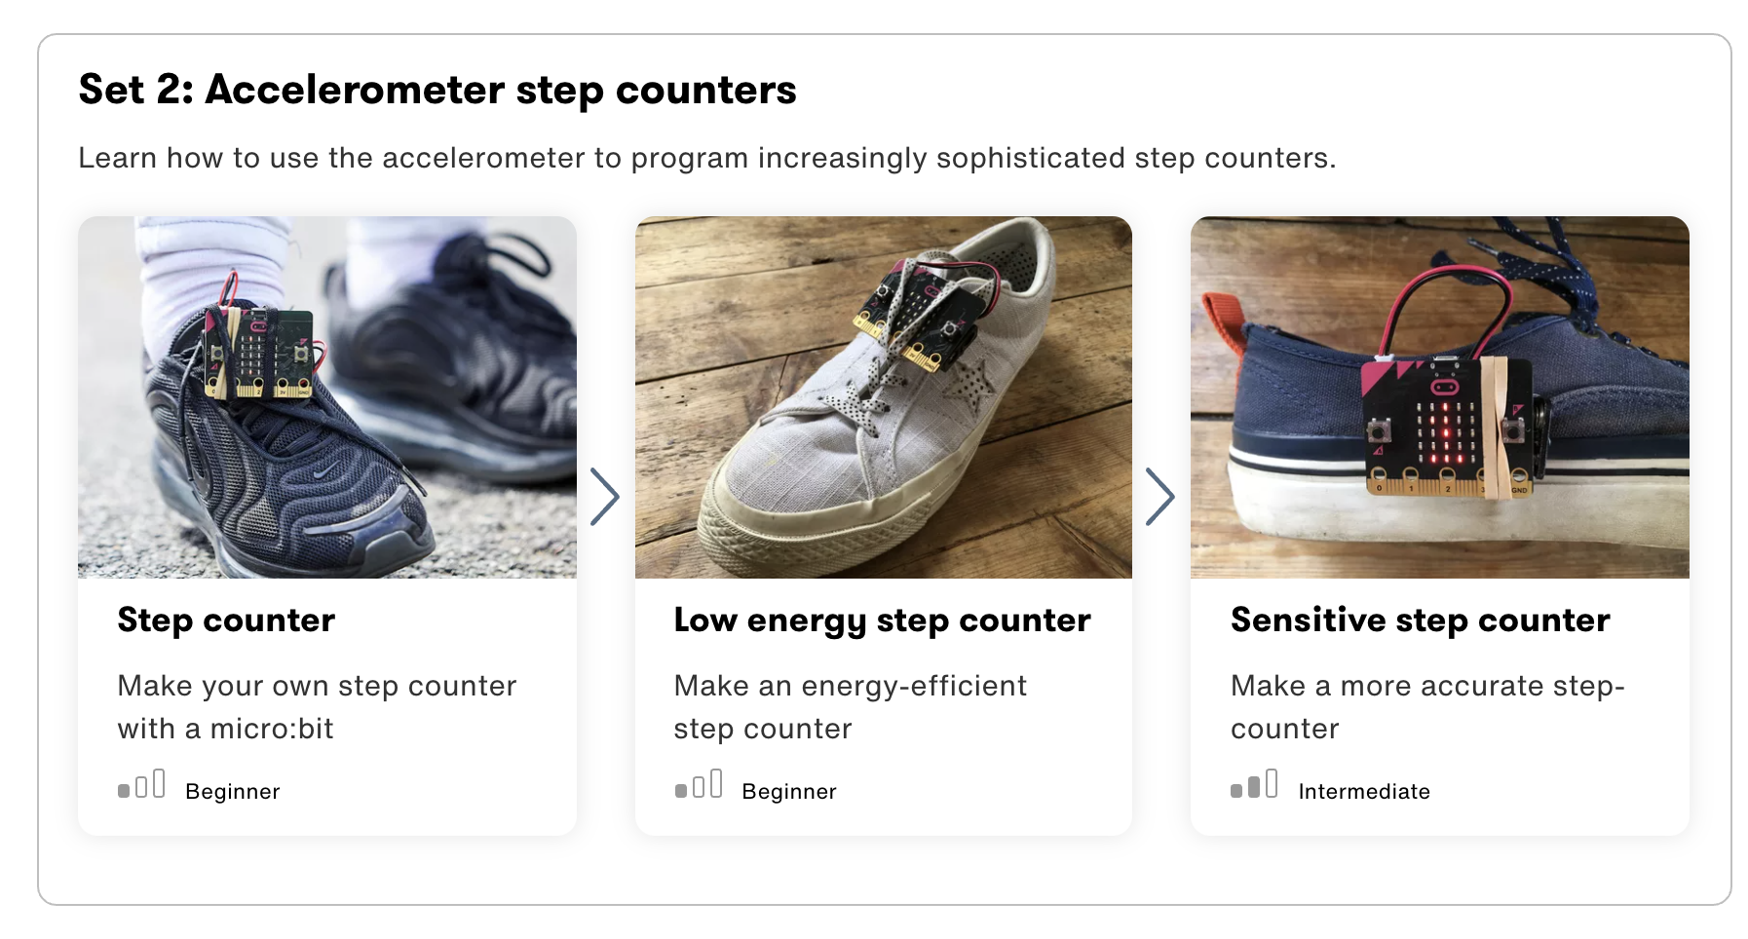

Slide 12
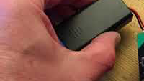
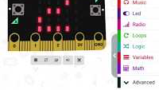
Step 1: The Project Step Counter
What is it?
Turn your micro:bit into a step counter (or pedometer) to help you track how active you are - and learn some coding at the same time!
What do I need?
micro:bit (or MakeCode simulator) with USB
MakeCode or Python editor
Battery pack (optional)
Something to attach the micro:bit to your shoe or leg – string, tape or Velcro

Slide 13
Step 2: How Does it Work?
Like the Dice project this program uses the micro:bit’s accelerometer to make something happen.
It counts how many times the micro:bit has been shaken. It stores this number in a variable called ‘steps’.
Variables are used by computers to store information that may change, such as the number of steps you’ve taken.
Every time the micro:bit accelerometer input senses a shake, the program increases the variable by 1, and shows the new number on the LED display output.

Slide 14
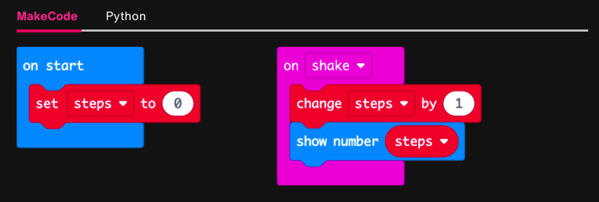
Step 3: Read It and Code It

Slide 15
Step 4: Share Your Creation!
Notes:
Have students walk around the room three times and then report their step count.

Slide 16
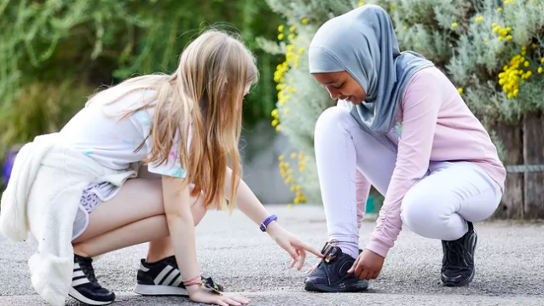
Step 5: Improve It
Add a button to reset the steps to 0.
Make the micro:bit beep each time a step is counted.
Advanced: Add a graphical representation of how many steps you’ve taken.

Slide 17
Step 1: The Project The Long-Lasting Step Counter
What is it?
Make a step counter with longer-lasting batteries.
What do I need?
micro:bit (or MakeCode simulator) with USB
MakeCode or Python editor
Battery pack (optional)
Something to attach the micro:bit to your shoe or leg – string, tape or Velcro

Slide 18
Step 2: How Does it Work?
Like the Step counter project this program uses the accelerometer to count a step every time the micro:bit is shaken and stores the total number in a variable called steps.
Keeping the LED lights on the micro:bit turned on requires more power. This program saves energy by only showing the step count when you press button A.
This means that the batteries will last longer, saving money, creating less waste and helping the environment.

Slide 19
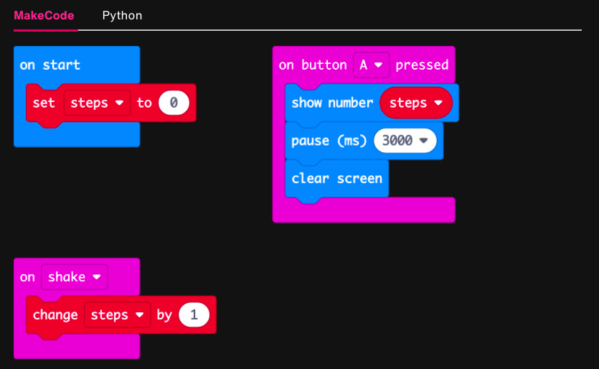
Step 3: Read It and Code It

Slide 20
Step 4: Share Your Creation!
Notes:
DANCE CONTEST! Play music and have kids dance and freeze when the music stops. Whoever accumulated the most steps is the winner.

Slide 21
Step 5: Improve It
Modify the program so button B sets the counter back to 0.
Advanced: think of ways of adapting other projects to make the batteries last longer.

Slide 22
Step 1: The Project A Custom Step Counter
What is it?
A step-counter you can make more accurate by tailoring it to your own walking style.
What do I need?
micro:bit (or MakeCode simulator) with USB
MakeCode or Python editor
Battery pack (optional)
Something to attach the micro:bit to your shoe or leg – string or Velcro

Slide 23
Step 2: How Does it Work?
The Step counter and Low energy step counter projects use the ‘shake’ gesture to count steps. The 'shake' gesture uses several accelerometer sensor readings to decide if the micro:bit has been shaken.
You may find that the ‘shake’ gesture isn’t triggered every time you take a step, or that it’s triggered too easily, leading to inaccurate counting of steps.
To make a more accurate step counter, instead of using the ‘shake’ gesture, this program uses numerical data from the accelerometer to decide whether you’ve taken a step and, if you have, increase the steps variable by 1.
Notes:
What you’ll learn
How the micro:bit can collect numerical acceleration data
How to apply thresholds to sensor data to trigger events like increasing a step counter

Slide 24
Step 2: How Does it Work?
How does it work?
If the acceleration is greater than (>) 1500, the steps variable is increased by one and show the step count on the LED display output. 1500 is the threshold – the point at which a movement will trigger a step to be counted.
You may need to change the 1500 number to make the step counter more accurate – but you can decide what threshold to use, whereas with the ‘shake’ gesture the threshold has been decided for you by the people who designed the micro:bit.
Modifying the threshold to work for you is called calibration.
Note that when micro:bit is not moving, the accelerometer gives a strength reading of about 1000. This is caused by the Earth’s gravity pulling down on the micro:bit. (WOW!!)

Slide 25
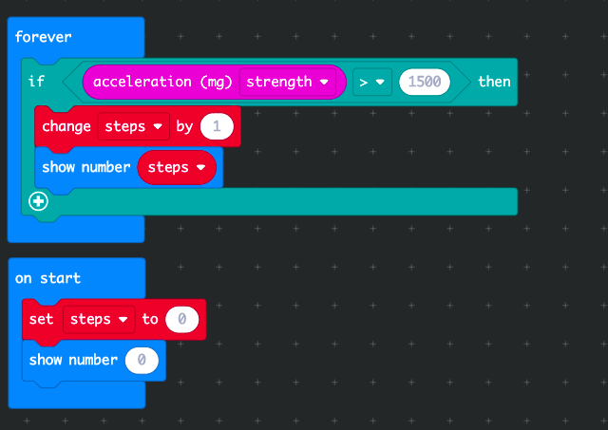
Step 3: Read It and Code It

Slide 26
Step 4: Share Your Creation!

Slide 27
Step 5: Improve It
Make your batteries last longer by changing the program so it only shows the number of steps when you press button A.
Modify the program so button B sets the counter back to 0.
Advanced: The accelerometer can measure forces in 3 dimensions, called the X, Y and Z axes. You can modify the code to choose which axis to measure, depending on which way up you fix your micro:bit to your leg or shoe.

Slide 28
BREAK!
20 hops on one foot, please!

Slide 29
NEXT TIME
Playing with Even More Sensors!!

Slide 30
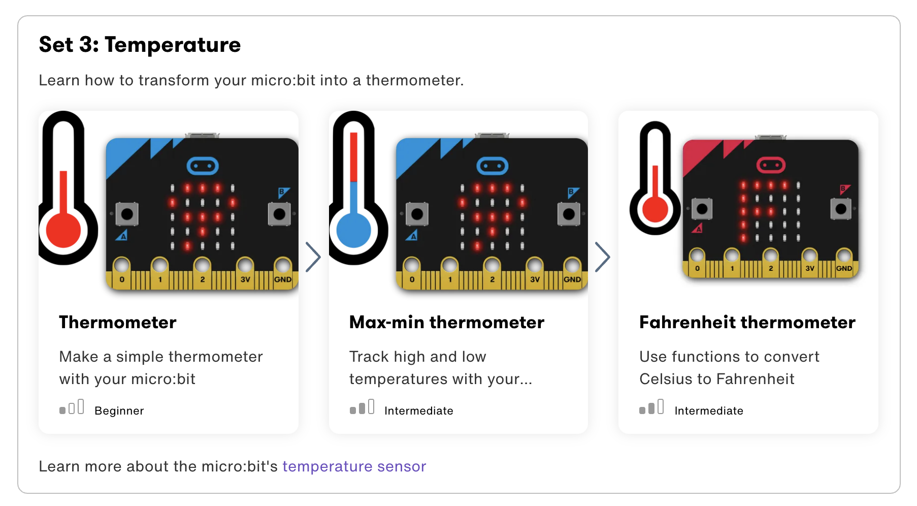

Slide 31

UNTIL NEXT TIME….
MicroMakers!
Slides and Script: Holly Krambeck (learningpython64@gmail.com)
Project Videos, Images, and Text: https://microbit.org/get-started

